Slide 1
Bank Loan Case Study
BY. Prajwal Pachare

Slide 2
Description
As a data analyst in a finance sector and in a bank I learn that how bank works and store data, I face lot of challenges while working on data set using EDA.
In this project I like to work on Univariate, Segmented Univariate, and Bivariate Analysis most and I first time work on it.
Tech-Stack Used
I used MS EXCEL 360 to perform this project and I use because it reliable to analyse data and perform eda also calculation.

Slide 3
INSIGHT
1. Identify Missing Data and Deal with it Appropriately: As a data analyst, you come across missing data in the loan application dataset. It is essential to handle missing data effectively to ensure the accuracy of the analysis.
In dataset we have 122 columns with 49999 rows to solve this huge dataset first how many value we have in column after that I found blank value in every column to calculate percentage how much we have blank value in each column and I decide a column have more than 30% blank value remove from dataset and rest of blank cell fill with average of each column,
So I found that out of 122 columns 55 columns have more than 30% values are blank so we remove it from dataset.
I found that column COMMONAREA_MODE &COMMONAREA_MEDI has most blank cell with 34960 blank cell.

Slide 4
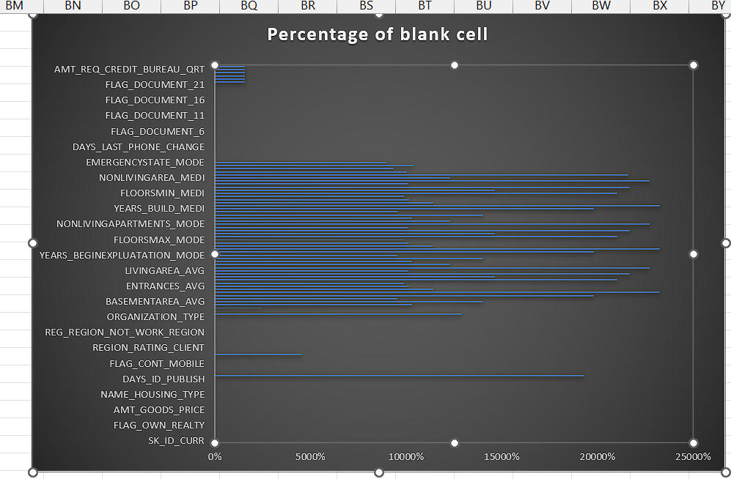

Slide 5
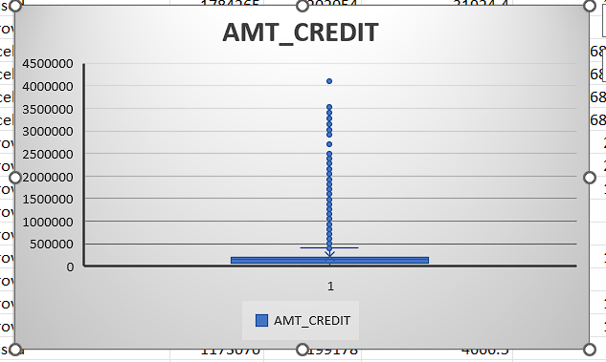
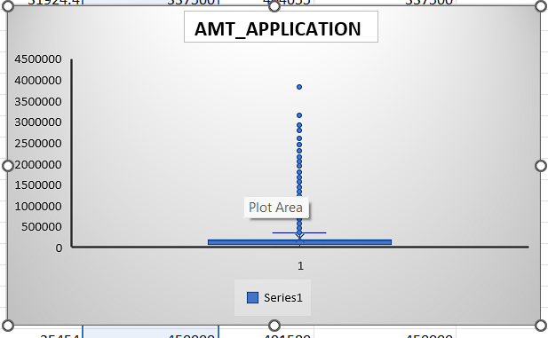
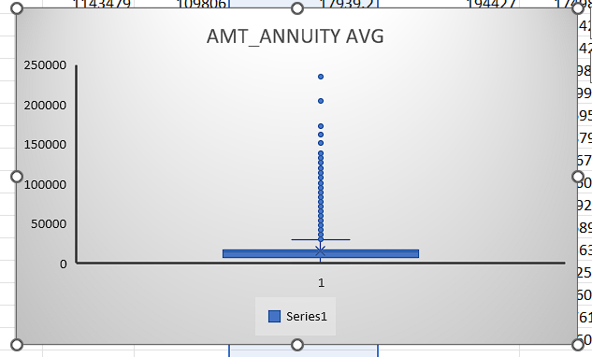
2. Identify Outliers in the Dataset: Outliers can significantly impact the analysis and distort the results. You need to identify outliers in the loan application dataset.
Here we can see a client have more than 4000000 amount credit that is not possible.

Slide 6
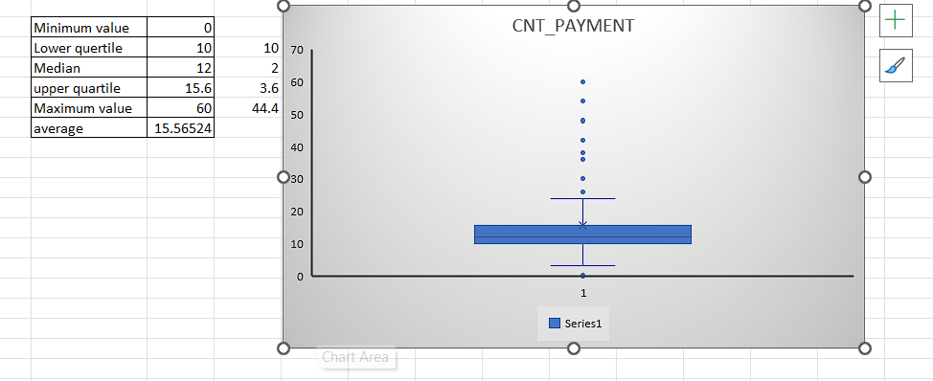
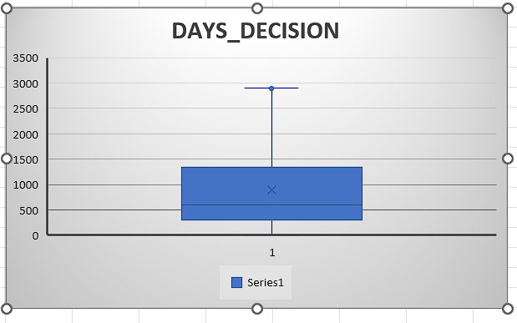
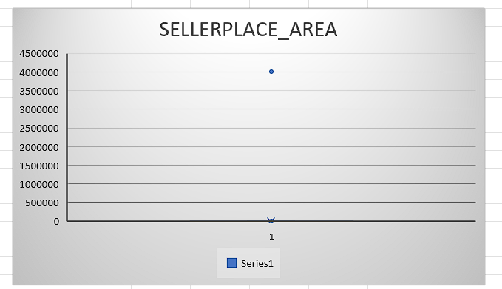

Slide 7
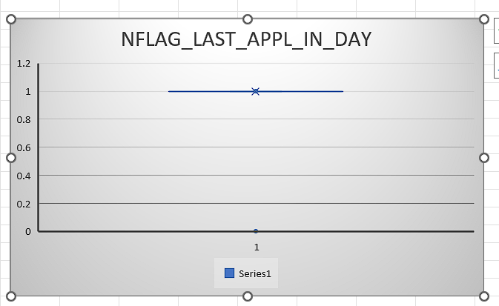
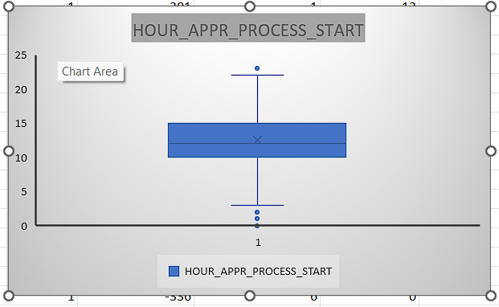
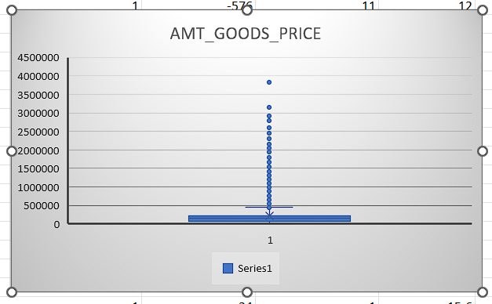

Slide 8
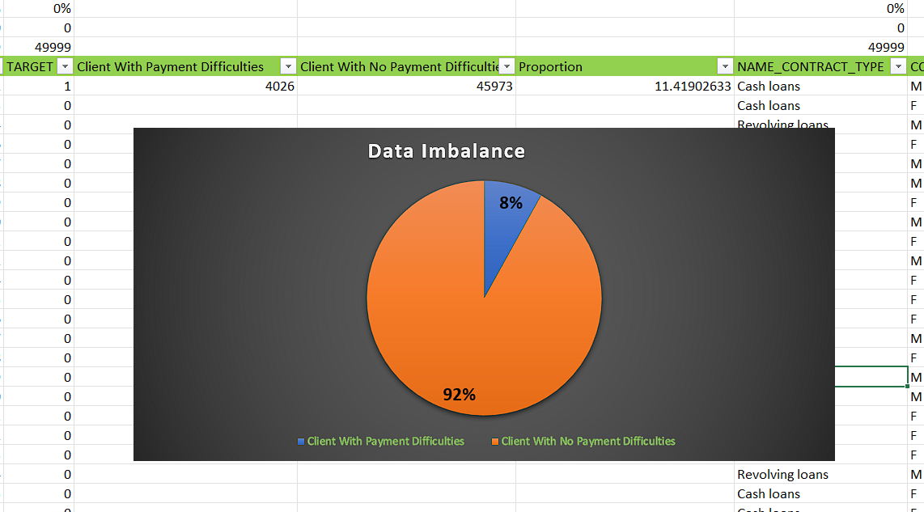
3. Analyze Data Imbalance: Data imbalance can affect the accuracy of the analysis, especially for binary classification problems. Understanding the data distribution is crucial for building reliable models.
First of all I found how many client have payment issue, so 4026 client have payment issue also I got proportion value 11.4190 that’s show we have most of non defaulter client.

Slide 9
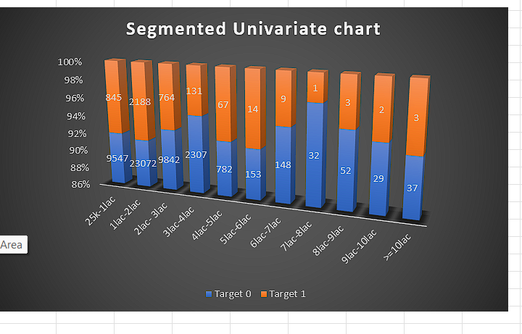
3. Perform Univariate, Segmented Univariate, and Bivariate Analysis: To gain insights into the driving factors of loan default, it is important to conduct various analyses on consumer and loan attributes.
In segmented univariate we take two sub category that show the client was approved or not blue one chow that not approve and another one show that not approve.

Slide 10
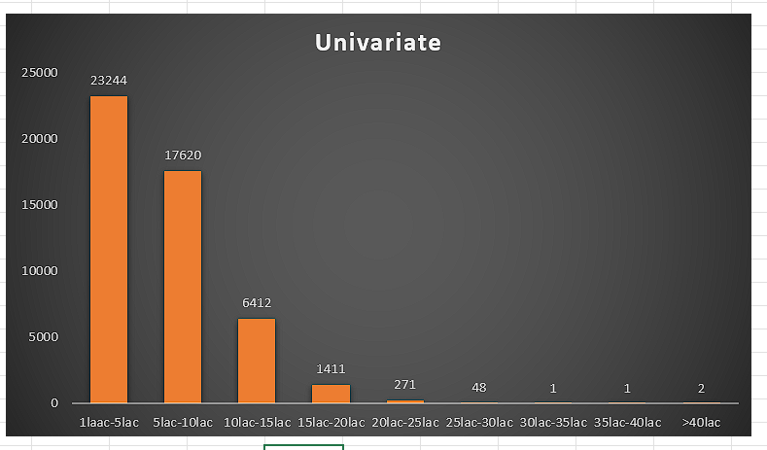
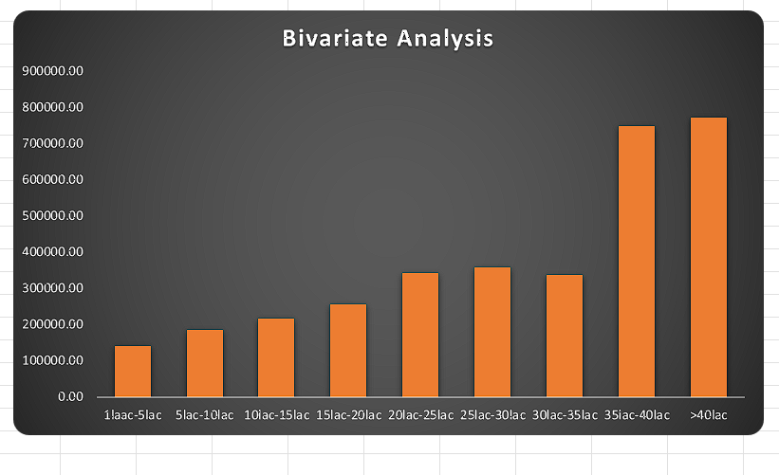
Univariate has only one column that’s we take applicant column o show how much applicant have credit value.
In Bivariate Analysis we show that average credit amount per income bin

Slide 11
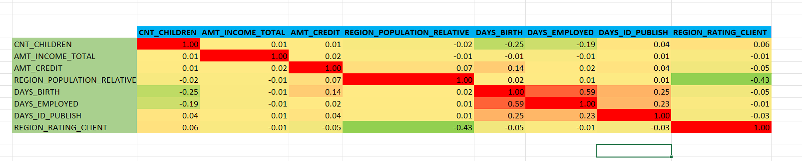
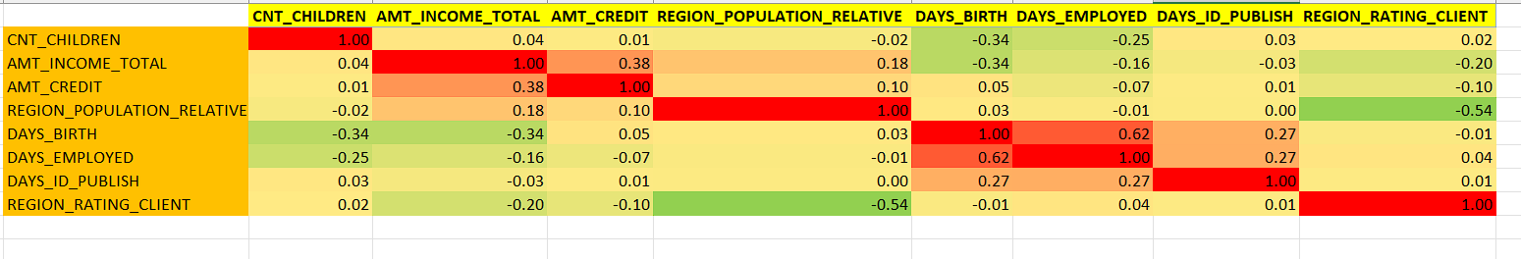
5. Identify Top Correlations for Different Scenarios: Understanding the correlation between variables and the target variable can provide insights into strong indicators of loan default.
To find correlation between each variable I created heat map that easily shows value ,but here we make tow part of dataset one that client have no difficulties and other one has difficulties with payment.
Client who have difficulties with payment (1)
Client who don’t have difficulties with payment ()

Slide 12
RESULT
Analyzing this huge dataset full of challenges, we solve each problem with practice and work hard to present this project as well as we create amazing charts to analyze the data.

